Slide 1

From Metadata to Music Genres: A Machine Learning Approach
By Brad Lightfoot
Supervised by ed mccann

Slide 2

Machine Learning
ML enables computers to find patterns and make decisions without being explicitly programmed.
Instead of giving step-by-step instructions, we show examples and let the machine figure it out.
The more data it sees, the smarter it gets.
Powered by clever math, not magic

Slide 3
The project
Classify music using genre
Use a machine learning model trained on metadata
A 60% accuracy was achieved
Don’t try this at home- I did it, so you don’t have to

Slide 4

Why Genre Prediction Matters
To bridge music and technology
Lay foundation for advanced audio analysis
Find an answer to “Can machines listen to music?”
Machine learning could be a stepping stone into the future

Slide 5
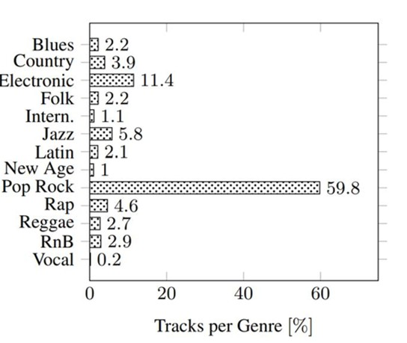
The data
Million songs metadata (MSD)
Tagtraum- statistical split (130,000 tracks)
Features: duration, tempo, key, mode, loudness, time signature, year of release, word count of artist name and word count in song title
13 genres
Challenges with the data:
Combining both data sets
How should it be split for training and testing?
Data imbalance

Slide 6
Which algorithm to use?
Approaches | One vs Rest Binary | SoftMax Multiclass
What is it? | Logistic regression developed for each class Classify by probability | Generalised extension of logistic regression Normalise probabilities
Benefits | Independent probabilities Less sensitive to class imbalance | A single model to classify all genres More efficient
Drawbacks | Requires training models for each class | Sensitive to class imbalance

Slide 7
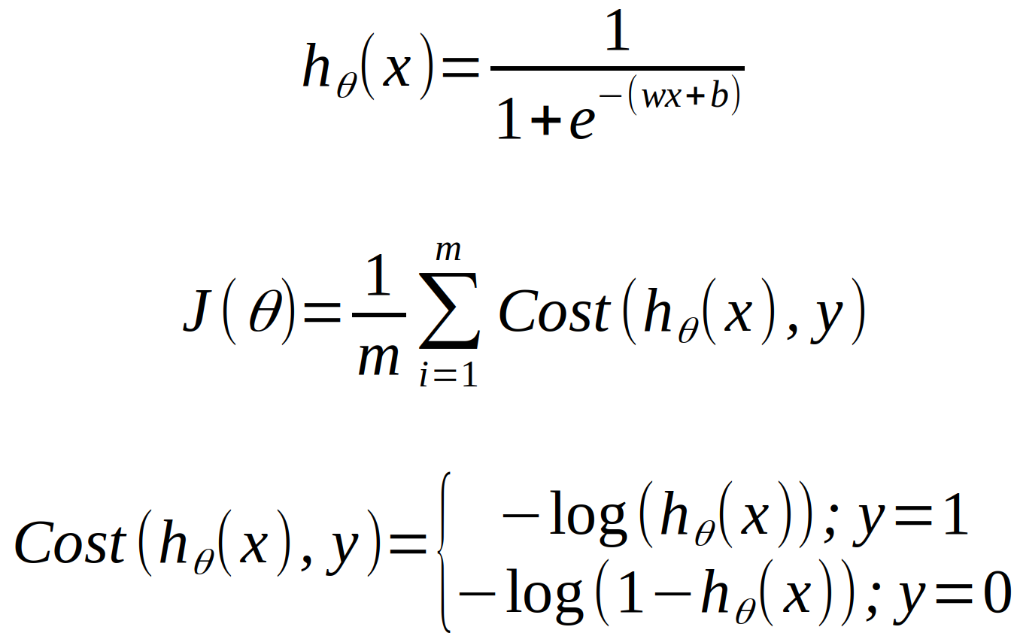
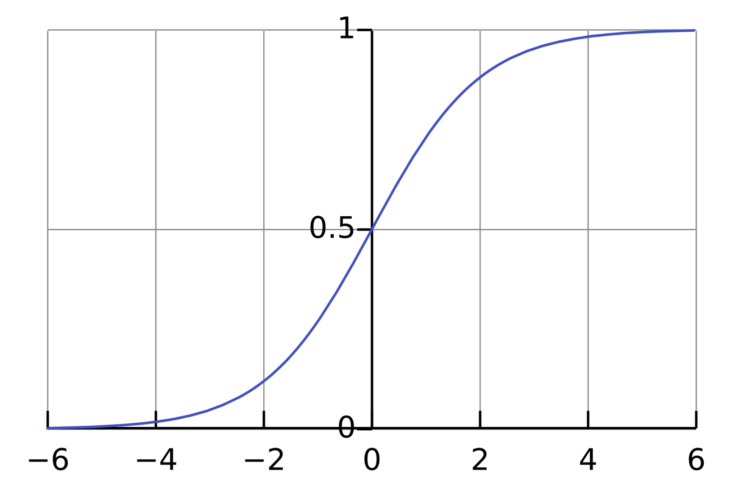
The One vs Rest Model
We chose the one vs rest Binary (OvR) approach
Large data imbalance
9-dimensional multiclass logistic regression
13 genre classifications

Slide 8
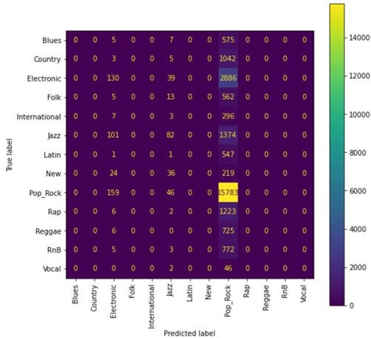
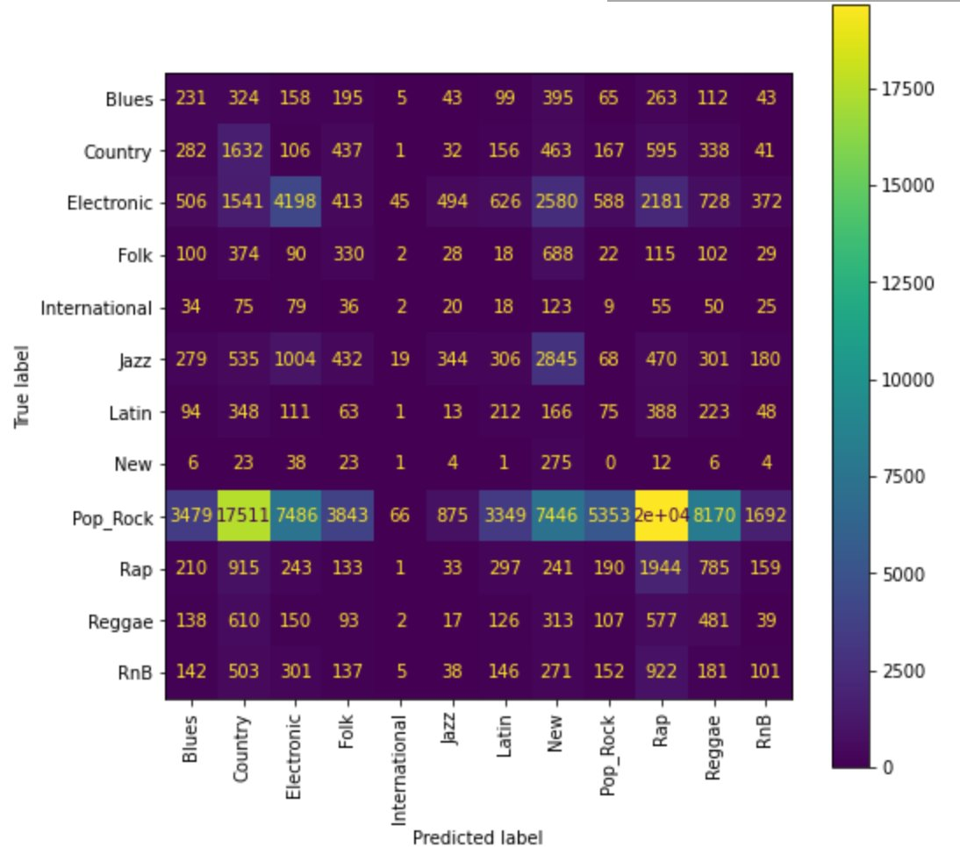
The Modles Statistics
Accuracy of 60% was achieved
2 hours training time
Some genres are never predicted
predictions are dominated
A second model using the same data with a different split was made (1000 of each genre)
Notes:
Train: 80% Stratified (106,935 songs) Test: 20% Stratified (26,741 songs)
Accuracy: 59.8%, Precision: 41.5% F1 Score: 0.46
Train: 9% (1000 songs/genre -vocal) Test: Leftover 91% (121,473 songs)
Accuracy: 12.4%, Precision: 56.7% F1 Score: 0.14

Slide 9
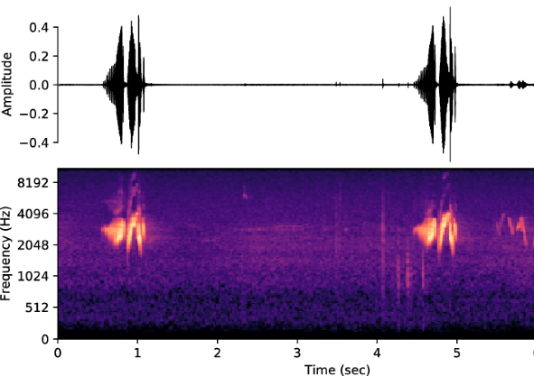
Implications of results
Machines interpret music
Metadata is poor for genre predictions
This could be done with more advanced ML (CNN)-Spectrogram
Notes:
Convolution neural network, using spectograms

Slide 10
Thank you
Any questions?

